Slide 1
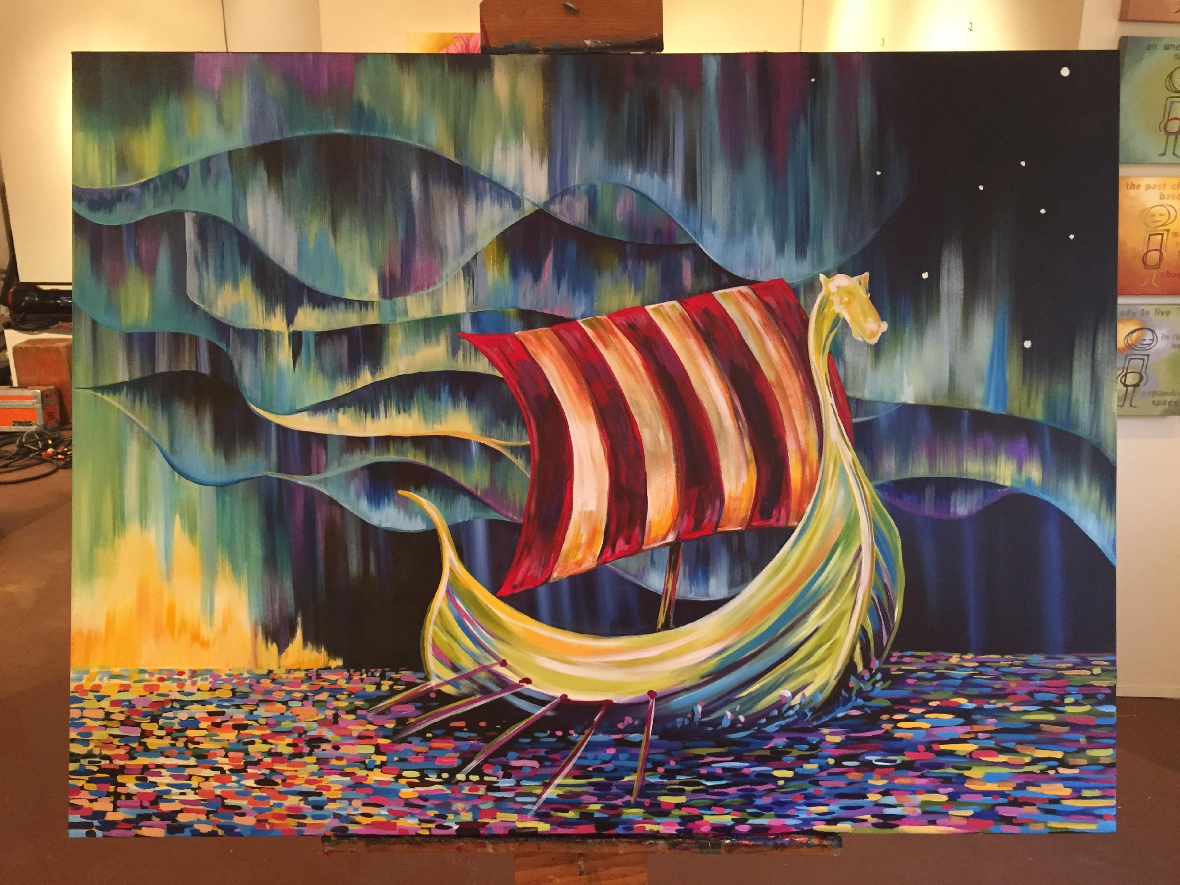
Shared Values
A Simple Promise
District Six

Slide 2
Mission Sons of Norway
The mission of Sons of Norway is to promote and to preserve the heritage & culture of Norway, to celebrate our relationship with other Nordic Countries, and to provide quality insurance and financial products to its members.

Slide 3
Sons of Norway Goals
Attain 300 new insurance members
Achieve $4.8 million in total life insurance premiums
Accomplish $16.5 million in total annuity premiums
Acquire 3,300 new members
Arrive at $200,000 Foundation funds raised

Slide 4
What IS in it for ME?
What reason (s) do people join sons of Norway
Fraternal benefit society
Mission
How do you pursue these interests?
How does a person and/or lodge promote and preserve our heritage and culture?
How Does Sons of Norway care for its members?

Slide 5
Membership
How do you join?
Local Lodge
District Lodge and Zone Director
International Lodge

Slide 6
LOCAL LODGE
Functions on its own but is part of the whole fraternal Sons of Norway
Has its own officers and bylaws.
Sets it own programs within the purposes of the Mission of Sons of Norway
Is financially independent

Slide 7
DISTRICT LODGE
District Six—Mission
The mission of District Six is to support Sons of Norway through communication, resources and opportunities
Officers are elected by the local lodge delegates at the District Convention
The Zone Director is elected by delegates from that Zone
Zone Directors is a liaison between the board and the local lodge officers and is an advisor

Slide 8
INTERNATIONAL LODGE
MEETS EVERY TWO YEARS (BIENNIALLY)
Sons of Norway is run between meetings by the International Board
The District elects at their Convention an International Director
Headquarters is run by a CEO hired by the International Board

Slide 9
THE THREE LEGGED STOOL
Sons of Norway has three distinctive services
Fraternal
Foundation
Financial

Slide 10
FRATERNAL
Membership
Viking Magazine
Cultural Skills Programs, recipe book, language lessons
Sports Medals Programs
Member Discounts
Lodge Governance—Lodge supplies, Newsletter services

Slide 11
FOUNDATION
The Sons of Norway Foundation is dedicated to funding activities that preserve and promote Norwegian heritage, positively affect members, and make Sons of Norway communities a more vibrant place to live. Be it through a student's scholarship for study, a cultural exchange experience, or assisting lodges to provide quality programs and community events – the Sons of Norway Foundation is true to its mission.

Slide 12
FOUNDATION
Creating opportunities for higher education as a means for success.
Showcasing our unique Norwegian heritage to wider audiences.
Exploring cross-cultural exchanges.
Providing humanitarian support to Sons of Norway members who are victims of natural disasters.

Slide 13
FINANCIAL
Advisor newsletter
Annuity Products
Insurance Products--
Free Facial Assessments
Financial Benefit counselors (FBC’s)

Slide 14
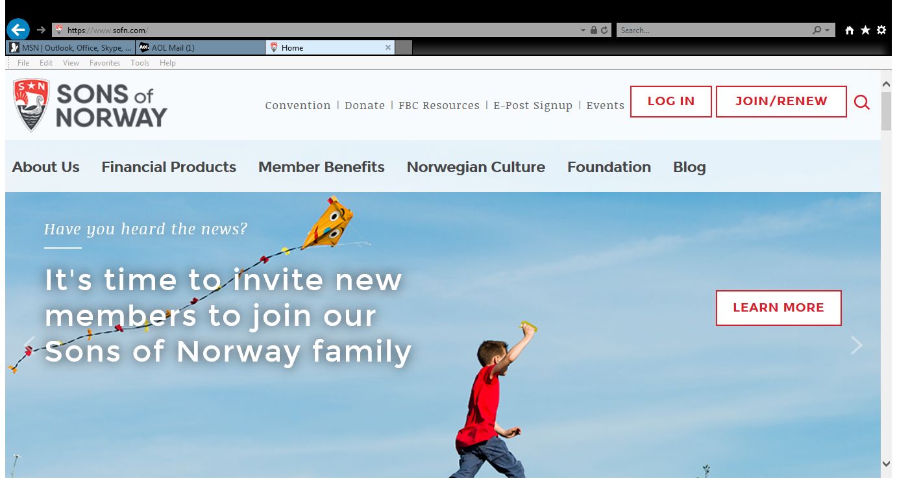
Sons of Norway—Resources/Website
Advisor newsletter
Annuity Products
Insurance Products--
Free Facial Assessments
Financial Benefit counselors (FBC’s)

Slide 15
Sons of Norway—Resources/Website
About US
Financial Products
Member Benefits
Norwegian Culture
Foundation
Member Resources

Slide 16
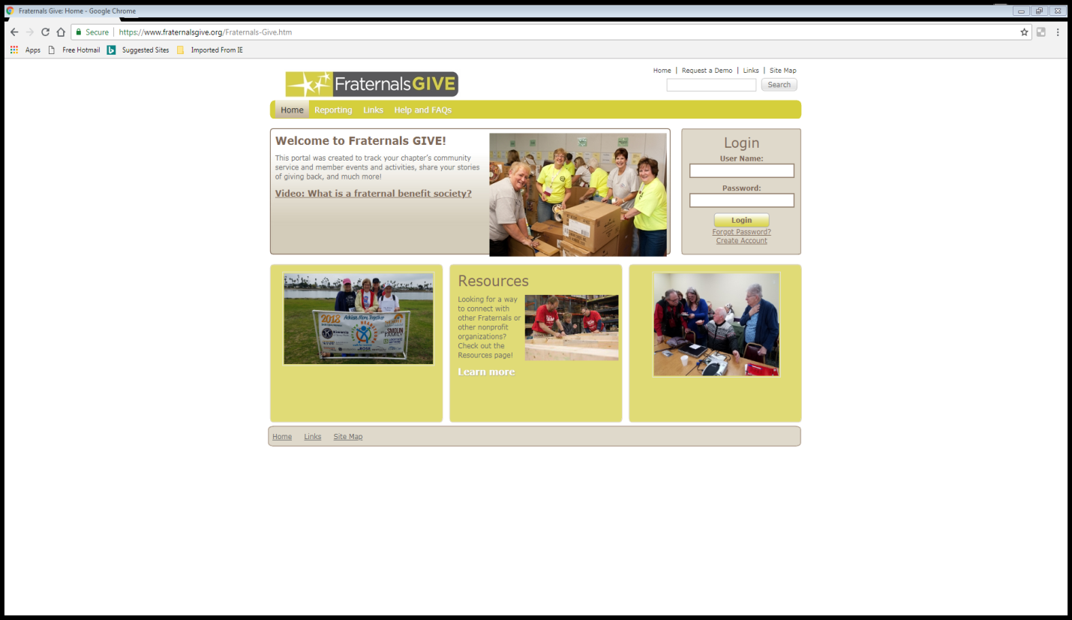
Fraternals Give

Slide 17
District Six—Resources/Website
Website
Resources for Facebook and Websites
Camp Norge
Century Club
Youth—Language and Heritage Camps
Youth Scholarships and Camperships
District Newsletter
District Culture Newsletter

Slide 18
Sons of Norway—Resources/Website
About US
Financial Products
Member Benefits
Norwegian Culture
Foundation
Member Resources

Slide 19
Local Lodge
Mission Oriented—Sons of Norway
Sets and Achieves Goals
Strong Leadership
Dynamic Programs and Social/Cultural Events
Recruits New Members and Retains Members
Always a Positive Attitude
Provides a Value Added Experience
Have Fun!

Slide 20
Local Lodge
Do a member Survey
Tradition
Make plans
See the Big Picture and be part of it
Include all three legs, the Fraternal, Foundation and Financial

Slide 21
CONVENTION 2020

Slide 22
Questions?

Slide 23
Contact Information
Name
Phone Number
Email

